Slide 1

Cabling A brief journey towards network wiring
Dr. Risala T Khan

Slide 2

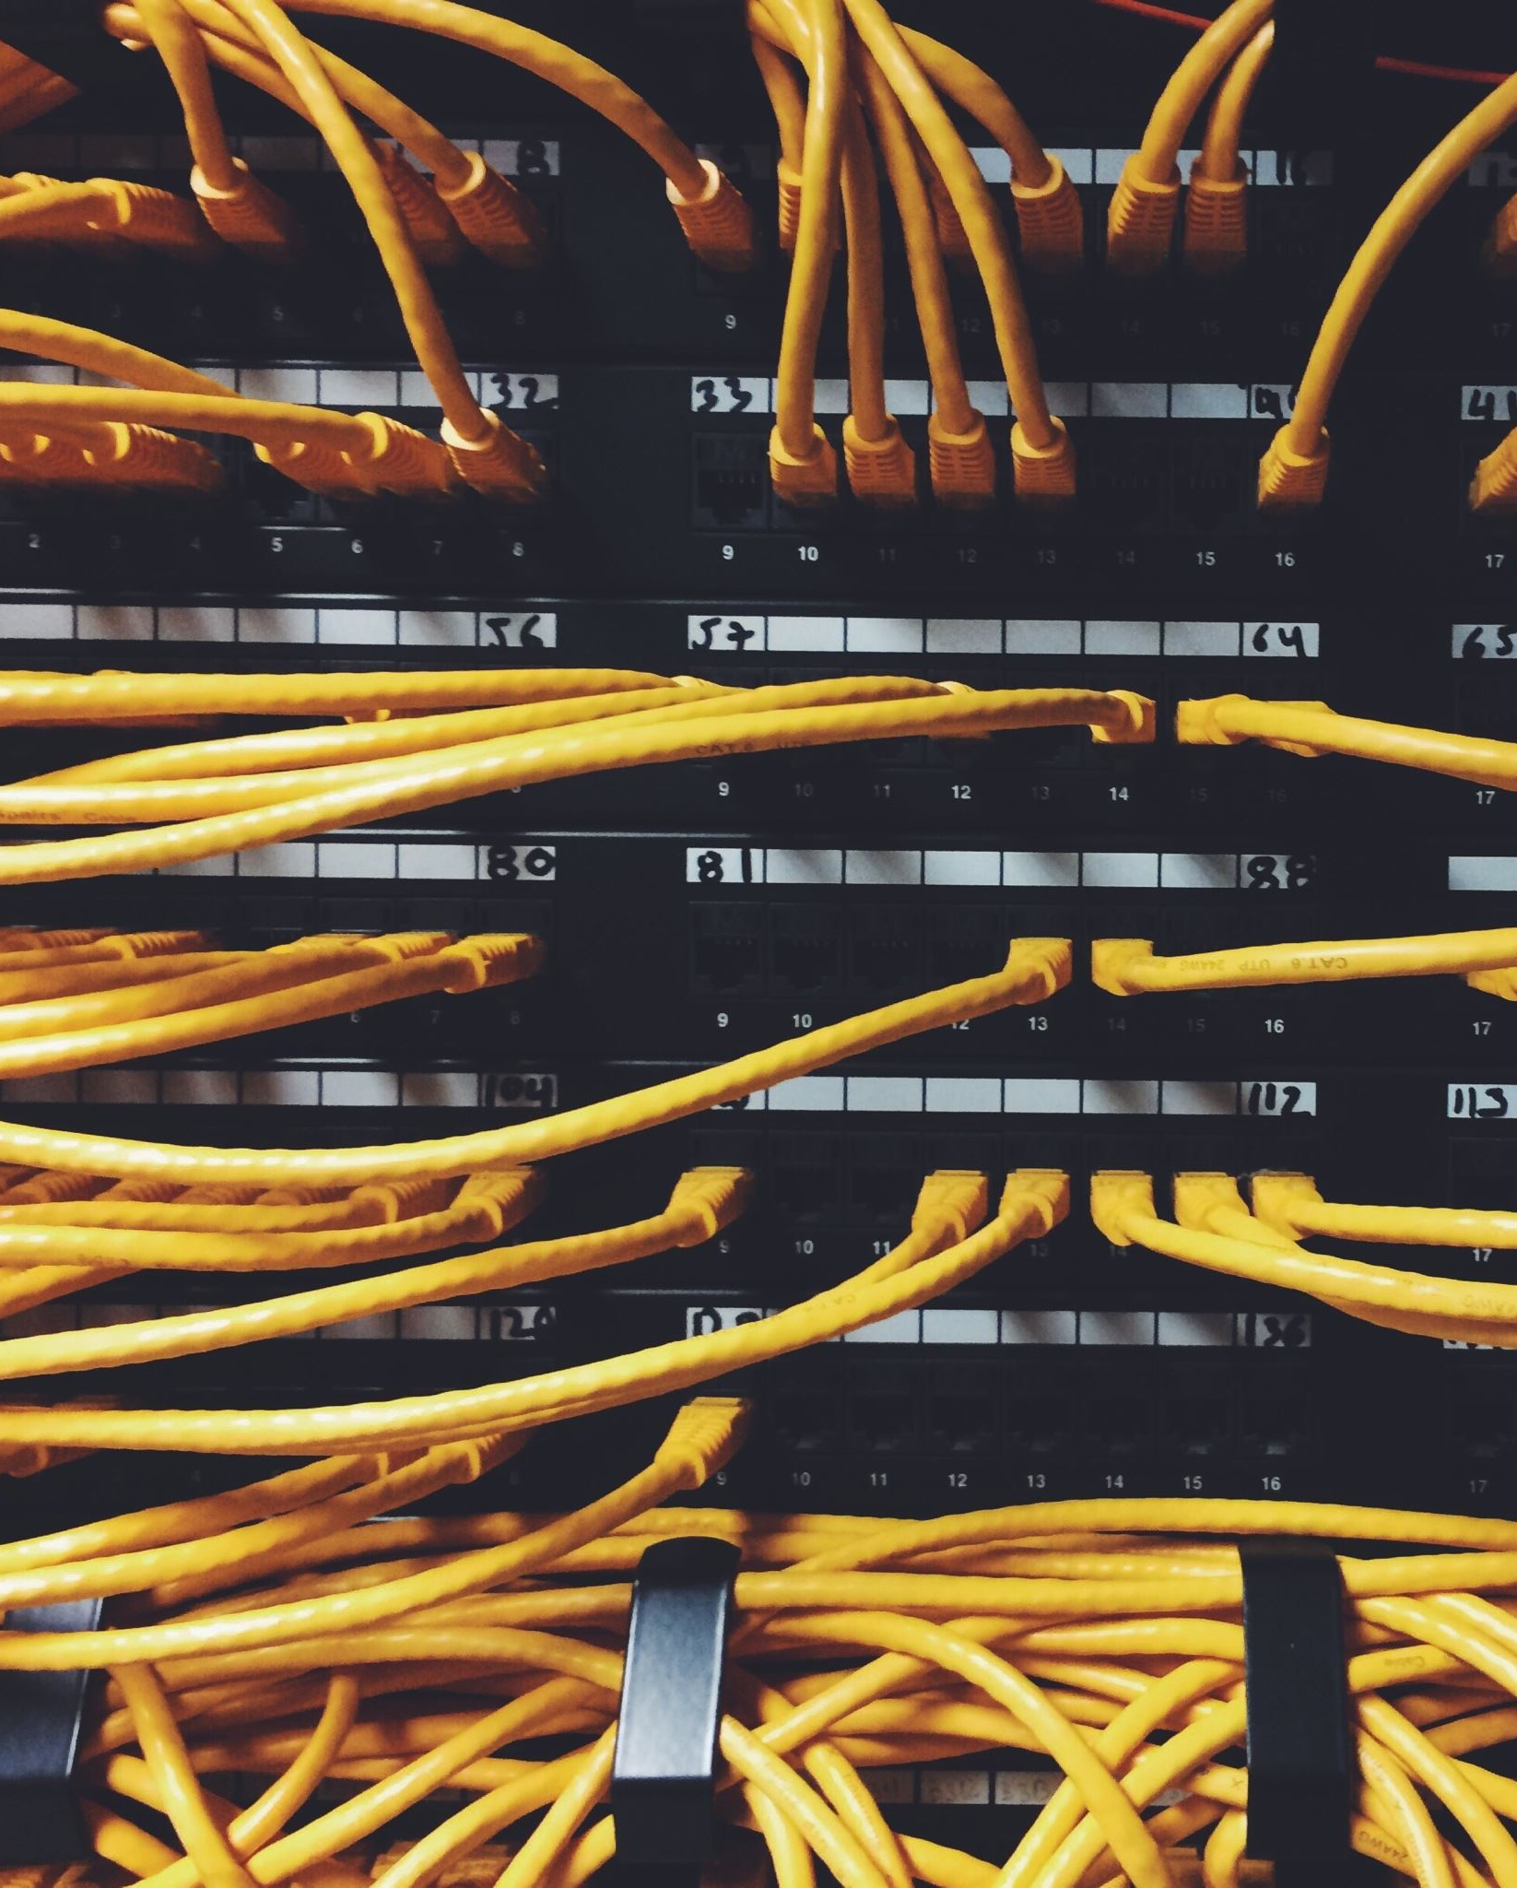
The Importance of Reliable Cabling
Data cabling typically accounts for less than 10 percent of the total cost of the network infrastructure.
● The life span of the typical cabling system is upwards of 16 years. Cabling is likely the second most long-lived asset you have (the first being the shell of the building).
● Nearly 70 percent of all network-related problems are due to poor cabling techniques and cable-component problems.
If you have installed the proper Category or grade of cable, the majority of cabling problems will usually be related to patch cables, connectors, and termination techniques. The permanent portion of the cable (the part in the wall) will not likely be a problem unless it was damaged during installation.

Slide 3
The Cost of Poor Cabling
The costs that result from poorly planned and poorly implemented cabling systems can be staggering.
One company that had recently moved into a new office space used the existing cabling, which was supposed to be Category 5 cable.
Almost immediately, 100Mbps Ethernet network users reported intermittent problems. These problems included exceptionally slow access times when reading e–mail, saving documents, and using the sales database.
After many months of network annoyances, the company finally had the cable runs tested.
Many cables did not even meet the minimum requirements of a Category 5 installation, and other cabling runs were installed and terminated poorly

Slide 4
Cabling and the Need for Speed
The past few years have seen some tremendous advances not only in networking technologies but also in the demands placed on them.
In the past 20 years, we have seen the emergence of standards for 10Mb Ethernet, 16Mb Token Ring, 100Mb FDDI, 100Mb Ethernet, 155Mb ATM (Asynchronous Transfer Mode), 655Mb ATM, 1Gb Ethernet, 2.5Gb ATM., and 10Gb Ethernet (over optical fiber only as of this writing).
Network technology designers are already planning technologies to support data rates of up to 100Gbps.

Slide 5
Cont…
The average number of nodes on a network segment has decreased dramatically, while the number of applications and the size of the data transferred has increased dramatically.
Applications are becoming more complex, and the amount of network bandwidth required by the typical user is increasing.

Slide 6
Types of Communication Media
Four major types of communications media (cabling) are available for data networking today: unshielded twisted pair (UTP), shielded or screened twisted pair (STP or ScTP), coaxial, and fiber optic (FO).
It is important to distinguish between backbone cables and horizontal cables.
Backbone cables connect network equipment such as servers, switches, and routers and connect equipment rooms and communication closets.
Horizontal cables run from the communication closets to the wall outlets.
For new installations, multistrand fiber-optic cable is essentially universal as backbone cable.

Slide 7
Twisted-Pair Cable
By far the most economical and widely installed cabling today is twisted-pair wiring.
Not only is twisted-pair wiring less expensive than other media, installation is also simpler, and the tools required to install it are not as costly.
Unshielded twisted pair (UTP) and shielded twisted pair (STP) are the two primary varieties of twisted pair on the market today.
Screened twisted pair (ScTP) is a variant of STP.

Slide 8
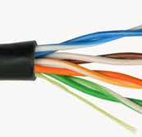
Unshielded Twisted Pair (UTP)
Unshielded twisted pair (UTP) for LANs first became common in the late 1980s with the advent of Ethernet over twisted-pair wiring and the 10Base-T standard.
UTP is cost effective and simple to install, and its bandwidth capabilities are continually being improved.
UTP cabling typically has only an outer covering (jacket) consisting of some type of nonconducting material.
This jacket covers one or more pairs of wire that are twisted together.

Slide 9
Cont..
This simple cable consists of a jacket that surrounds four twisted pairs.
Each wire is covered by an insulation material with good dielectric properties.
For data cables, this means that in addition to being electrically nonconductive, it must also have certain properties that allow good signal propagation.
Its great popularity is mostly due to the cost and ease of installation.
With every new generation of UTP cable, network engineers think they have reached the limits of the UTP cable’s bandwidth and capabilities.

Slide 10
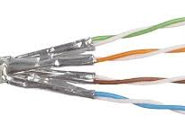
Shielded Twisted Pair (STP)
Shielded twisted-pair (STP) cabling was first made popular by IBM when it introduced Type classification for data cabling.
Though more expensive to purchase and install than UTP, STP offers some distinct advantages.
STP cable is less susceptible to outside electromagnetic interference (EMI) than UTP cabling because all cable pairs are well shielded

Slide 11
Cont….
Simply installing STP cabling does not guarantee you will improve a cable’s immunity to EMI or reduce the emissions from the cable.
Several critical conditions must be met to achieve good shield performance:
● The shield must be electrically continuous along the whole link.
● All components in the link must be shielded. No UTP patch cords can be used.
● The shield must fully enclose the pair, and the overall shield must fully enclose the core. Any gap in the shield covering is a source of EMI leakage.
● The shield must be grounded at both ends of the link, and the building grounding system must conform to grounding standards (such as TIA/EIA-607).

Slide 12
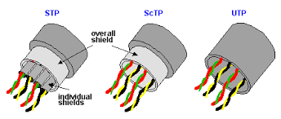
Screened Twisted Pair (ScTP)
A recognized cable type in the ANSI/TIA/EIA-568-B Standard is screened twisted-pair (ScTP) cabling, a hybrid of STP and UTP cable.
ScTP cable contains four pairs of 24 AWG, 100-ohm wire surrounded by a foil shield or wrapper and a drain wire for bonding purposes.
ScTP is also sometimes called foil twisted-pair (FTP) cable because the foil shield surrounds all four conductors.
ScTP cable is essentially STP cabling that does not shield the individual pairs; the shield may also be smaller than some varieties of STP cabling

Slide 13
Cont…
The foil shield is the reason ScTP is less susceptible to noise.
In order to implement a completely effective ScTP system, however, the shield continuity must be maintained throughout the entire channel—including patch panels, wall plates, and patch cords.
Standard eight-position modular jacks (commonly called RJ-45s) do not have the ability to ensure a proper ground through the cable shield.
So special mating hardware, jacks, patch panels, and even tools must be used to install an ScTP cabling system.
Many manufacturers of ScTP cable and components exist—just make sure to follow all installation guidelines.

Slide 14
Not All UTP Is Created Equal!
Though two cables may look identical, their supported data rates can be dramatically different.
Older UTP cables that were installed to support telephone systems may not even support 10Base-T Ethernet.
The ANSI/TIA/EIA-568-B Standard helps consumers choose the right cable (and components) for the right application.
The Standard has been updated over the years and currently defines four categories of UTP cable: Categories 3, 5, 5e, and 6.
Note that Category 5 requirements have been moved to an addendum and are not officially recognized as an approved cable for new installations.

Slide 15
Cont…
Category 1 (not defined by ANSI/TIA/EIA-568-B) :
This type of cable usually supports frequencies of less than 1MHz.
Common applications include analog voice telephone systems.
It never existed in any version of the 568 Standard.
Category 2 (not defined by ANSI/TIA/EIA-568-B):
This cable type supports frequencies of up to 4MHz.
It’s not commonly installed, except in installations that use twisted-pair ArcNet and Apple LocalTalk networks.
Its requirements are based on the original, proprietary IBM Cabling System.
It never existed in any version of the 568 Standard.
Category 3 (recognized cable type in ANSI/TIA/EIA-568-B):
This type of cable supports data rates up to 16MHz.
This cable was the most common variety of UTP for a number of years starting in the late 1980s.
Common applications include 4Mbps UTP Token Ring, 10Base-T Ethernet, 100Base-T4, and digital and analog telephone systems.
Its inclusion in the 568-B Standard is for voice applications.

Slide 16
Cont….
Category 4 (not defined by ANSI/TIA/EIA-568-B):
Cable belonging to Category 4 was designed to support frequencies of up to 20MHz, specifically in response to a need for a UTP solution for 16Mbps Token Ring LANs.
It was quickly replaced in the market when Category 5 was developed, as Category 5 gives five times the bandwidth with only a small increment in price.
Category 4 was a recognized cable in the 568-A Standard, but it has been dropped from ANSI/TIA/EIA-568-B.

Slide 17
Cont….
Category 5 (included in ANSI/TIA/EIA-568-B for informative purposes only)
Category 5 was the most common cable installed, until new installations began to use an enhanced version.
It may still be the cable type most in use because it was the cable of choice during the huge infrastructure boom of the 1990s.
It was designed to support frequencies of up to 100MHz.
Applications include 100Base-TX, PMD (FDDI over copper), 155Mbps ATM over UTP, and thanks to sophisticated encoding techniques, 1000Base-T Ethernet.

Slide 18
Cont…
Category 5e (recognized cable type in ANSI/TIA/EIA-568-B)
Category 5e (enhanced Category 5) was introduced with the TIA/EIA-568-A-5 addendum of the cabling Standard.
Even though it has the same rated bandwidth as Category 5, i.e., 100MHz, additional performance criteria and a tighter transmission test requirement make it more suitable for high-speed applications such as Gigabit Ethernet.
Applications are the same as those for Category 5 cabling.
It is now the minimum recognized cable category for data transmission in ANSI/TIA/EIA-568-B.

Slide 19
Cont….
Category 6 (recognized cable type in ANSI/TIA/EIA-568-B)
Category 6 cabling was officially recognized with the publication of an addition to ANSI/TIA/EIA-568-B in June 2002.
In addition to more stringent performance requirements as compared to Category 5e, it extends the usable bandwidth to 200MHz.
Its intended use is for Gigabit Ethernet and other future high-speed transmission rates.
Successful application of Category 6 cabling requires closely matched components in all parts of the transmission channel, i.e., patch cords, connectors, and cable.

Slide 20
Coaxial Cable
At one time, coaxial cable was the most widely used cable type in the networking business.
It is still widely used for closed-circuit TV and other video distribution.
However, it is falling by the wayside in the data-networking arena.
Coaxial (or just coax) cable is difficult to run and is generally more expensive than twisted-pair cable.
In defence of coaxial cable, however, it provides a tremendous amount of bandwidth and is not as susceptible to outside interference as is UTP.
Overall installation costs might also be lower than for other cable types because the connectors take less time to apply.

Slide 21
Optical-Fiber Cable
As late as 1993, it seemed that in order to move toward the future of desktop computing, businesses would have to install fiber-optic cabling directly to the desktop.
Although for most of us fiber to the desktop is not yet a practical reality, fiber-optic cable is touted as the ultimate answer to all our voice, video, and data transmission needs and continues to make inroads in the LAN market.

Slide 22
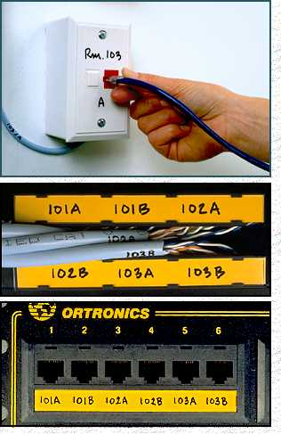
Structured Cabling Infrastructure
Cabling
Mounted and permanent
Allows patching
Comfort that infrastructure is OK
Components:
Information Outlet with Face Plate
Patch Panel
UTP Cable
Patch Cord

Slide 23
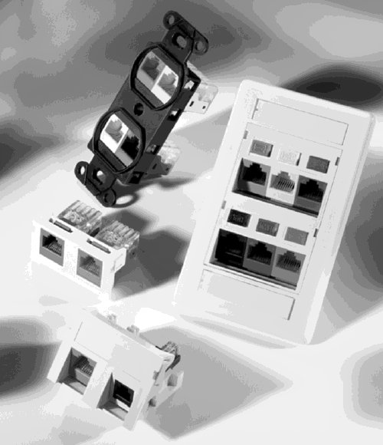
I/O & Faceplates
Cabling
Faceplate mounts on or in wall or in raceway
Single or Dual Information Outlet (I/O)
Provide network connectivity to the Hosts through a Patch Cord

Slide 24
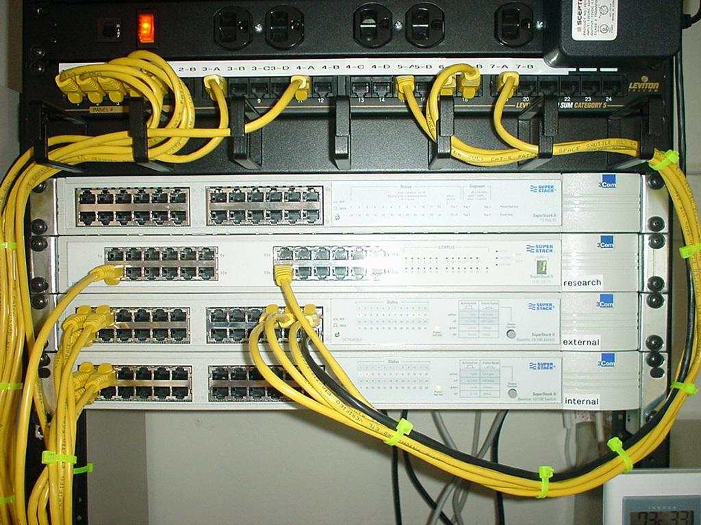
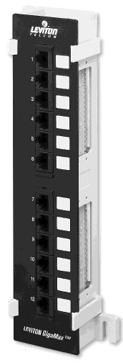
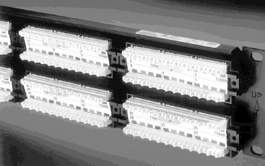
Patch Panel
Cabling
Termination punchdown in back
Patch cord plugin in front

Slide 25
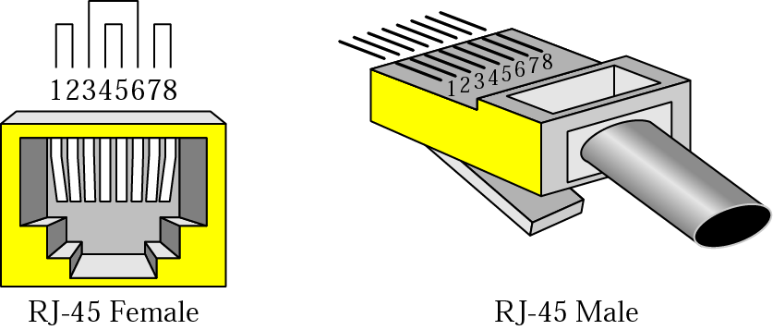
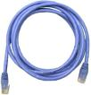
Patch Cord & UTP Connectors
Cabling

Slide 26
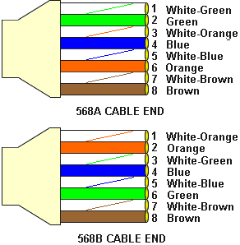
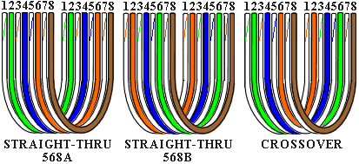
Color Codes
Cabling
Data Tx: 1 & 2
Data Rx: 3 & 6
Crossover
1 ⬄ 3
2 ⬄ 6
PoE +VDC: 4 & 5
PoE -VDC: 7 & 8

Slide 27
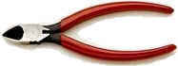
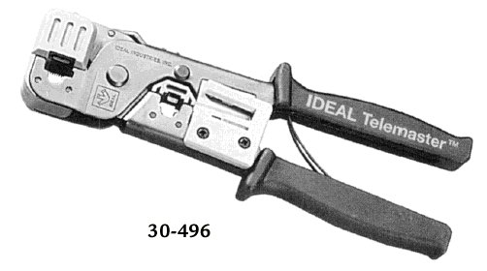
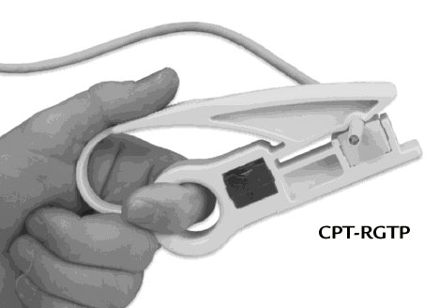
Cutting, Striping & Crimping Tools
Cabling
Make your own patch cords
Cuts and strips pairs
RJ45 end crimped onto ends of wire

Slide 28
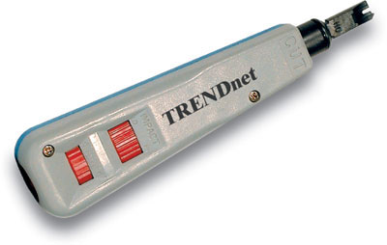
Punching Tool
Cabling
Terminates wires to back of patch panels and in Information Outlets

Slide 29

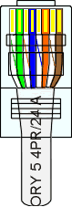
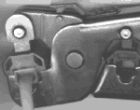
Making Cables
Cabling

Slide 30
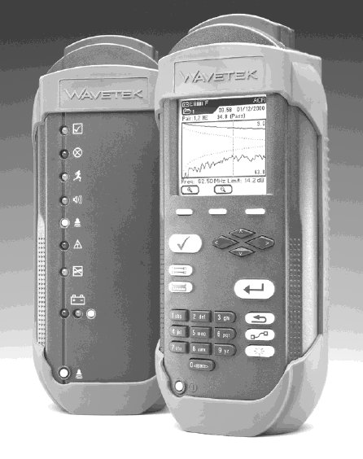
Wire Testing Equipment
Cabling
Test wire for correct termination of 8 wires
Test for speed capabilities

Slide 31
Cabling Rules
Cabling
Try to avoid running cables parallel to power cables.
Do not bend cables to less than four times the diameter of the cable.
If you bundle a group of cables together with cable ties (zip ties), do not over-cinch them. You should be able to turn the tie with fingers.
Keep cables away from devices which can introduce noise into them. Here's a short list: copy machines, electric heaters, speakers, printers, TV sets, fluorescent lights, copiers, welding machines, microwave ovens, telephones, fans, elevators, motors, electric ovens, dryers, washing machines, and shop equipment.
Avoid stretching UTP cables (tension when pulling cables should not exceed 25 LBS).
Do not run UTP cable outside of a building. It presents a very dangerous lightning hazard!
Do not use a stapler to secure UTP cables. Use telephone wire/RJ6 coaxial wire hangers which are available at most hardware stores.

Slide 32
STRAIGHT THROUGH AND CROSSOVER WIRING
Wiring within a twisted pair cable is configured as either
Straight through, where each wire (or pin) is attached to the same contact point at each end
Crossover, where transmit contacts on each end of the cable are connected to the receive contact at the other end

Slide 33
STRAIGHT THROUGH WIRING

Slide 34
CROSSOVER WIRING

Slide 35
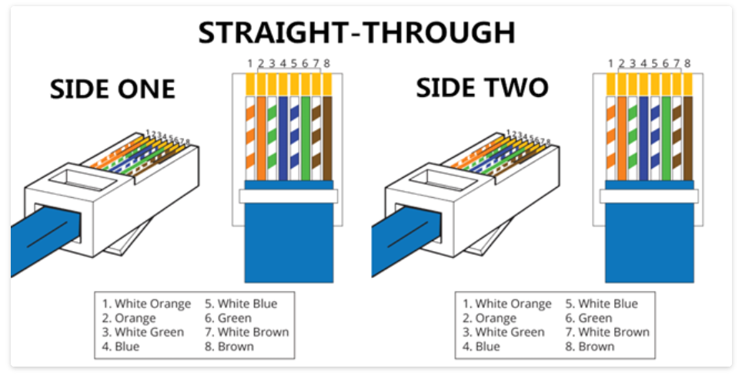
What Is Straight Through Cable?
A straight through cable is a type of twisted pair cable that is used in local area networks to connect a computer to a network hub such as a router.
This type of cable is also sometimes called a patch cable and is an alternative to wireless connections where one or more computers access a router through a wireless signal.
On a straight through cable, the wired pins match.
Straight through cable use one wiring standard:
both ends use T568A wiring standard or both ends use T568B wiring standard.

Slide 36
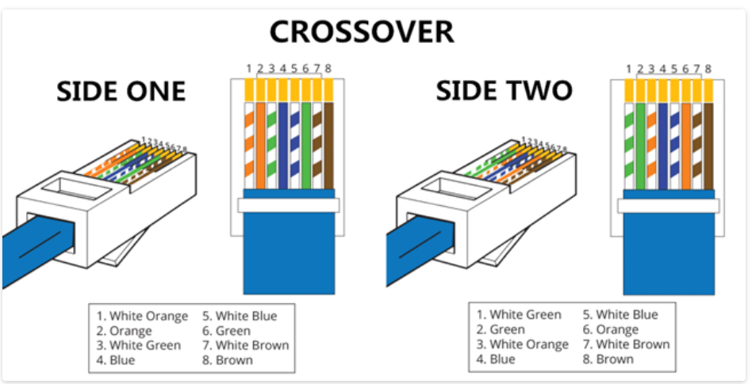
What Is Crossover Cable?
A crossover Ethernet cable is a type of Ethernet cable used to connect computing devices together directly.
Unlike straight through cable, the RJ45 crossover cable uses two different wiring standards: one end uses the T568A wiring standard, and the other end uses the T568B wiring standard.
The internal wiring of Ethernet crossover cables reverses the transmit and receive signals.
It is most often used to connect two devices of the same type: e.g. two computers (via network interface controller) or two switches to each other.

Slide 37

SELF STUDY
DIFFERENCE BETWEEN STRAIGHT THROUGH & CROSS OVER

